Slide 1
The Making of National Movements : 1870s-1947
Presented by:
Soham Joshi
Nameer Shaikh
Ankit Wankhede

Slide 2
Content
The Emergence of Nationalism
A Nation in Making
Freedom is our Bright Right
The Growth of Mass Nationalism
The Advent of Mahatma Gandhi
The Rowlett Satyagraha
The Happenings of 1922-29
Dandi March
Quit India
Towards Independence and Partition

Slide 3
The Emergence of Nationalism
India was the people of India and all the people irrespective of class, colour, caste, creed, language or gender are Indians.
The awareness of being Indian and that its resources and systems were meant for allot them led to see the trace nature and role of British in India.
Poona Sarvajanik Sabha and many such associations functioned in specific parts of country their goals were stated as the goals of all the people of India.
The Arms Act was passed in 1878, disallowing Indians from possessing arms.
In 1883 Lord Ripon’s Law Member, Sir Courtenay llbert introduced a bill called llbert bill.
The Indian National Congress was established in 1885. It included 72 delegates from different parts of the country which included leaders like DadaBhai Naoroji, W.C. Bonnerji, Surendranath Bannerji, Romesh Chandra Dutt, S. Subramania IyerPherozeshah Mehta and Badruddin Tyabji.

Slide 4
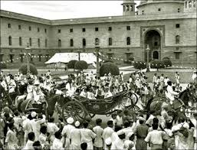
A Nation in Making
In the first twenty years Congress was ‘moderate’ in its objectives and methods
A greater voice for Indians in the government and in administration was their demand.
It demanded the separation of judiciary from the executive, the repeal of Arms Act and freedom of speech and expression.
It also demanded the separation of judiciary from the executive, the repeal of Arms Act and freedom of speech and expression.
The early Congress raised a number of economic issues. It declared that British rule had led to poverty and famines, increase in land revenue had impoverished peasant and Zamindars and there was food shortage because of exports and grains to Europe.

Slide 5
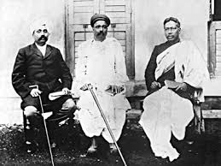
Freedom is our Bright Right
In Bengal, Maharashtra and Punjab, leaders such as Bipin Chandra Pal, Bal Gangadhar Tilak and Lala Lajpat Rai popularly known as ‘Lal, Bal, Pal’, strongly criticized the policies of the colonial government.
They demanded ‘Swaraj’. Tilak declared, ‘Freedom is my birth right and I shall have it’.
In 1905, Viceroy Curzon announced the partition of the biggest province British of India, Bengal which included Bihar and parts of Orissa.

Slide 6
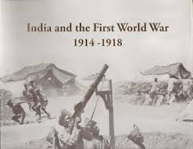
The Growth of Mass Nationalism
After 1919 the struggle against Britain rule gradually became a mass movement, inworkers. volving peasants, tribals, students and women in large numbers and factory.
The first World War broke out in 1914 and altered the economic and political situation in India .
India was dragged into the war and this led to a huge rise in defence expenditure of the government of India.
Increased military expenditure and the demands for war supplies led to a sharp rise in prices which create great difficulties for the common people.
The war lead the British to expand their army. The government forced the villages in India to send their soldiers for an alien cause.

Slide 7
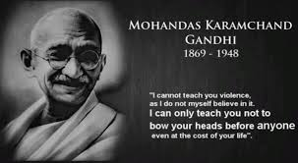
The Advent of Mahatma Gandhi
Mahatma Gandhi was born on 2nd October 1869 at Porbandar in Gujarat.
He studied law in England and went to South Africa to practice law and stayed there for 20 years.
He emerged as a mass leader of India.
In South Africa, Gandhiji struggle for the Indians in non-violent marches against racist restrictions and had earned great respect and popularity both at national and international level.
Mahatma Gandhi spent his initial years in India travelling throughout the country understanding the people, their needs and the overall situation.
Gandhiji launched local movements in Champaran, Kheda and Ahmedabad in which he received success.

Slide 8
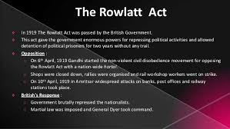
The Rowlett Satyagraha
In 1919, the government pass the Rowlett Act and empowered the provincial government to search any place and arrest any person whom it suspected without a warrant.
Gandhiji launched a Satyagraha against the Rowlatt Act which curbed the fundamental rights such as the freedom of expression and strengthened police powers.
Mahatma Gandhi and Mohammad Ali Jinnah criticized the act as ‘devilish’ and tyrannical.
In April 1919, a nation-wide hartal was launched and government used brutal measures to suppress them. The Jallianwala Bagh massacre inflicted by General Dyerin Amritsar on Baisakhi day was a part of this repression.

Slide 9
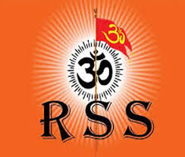
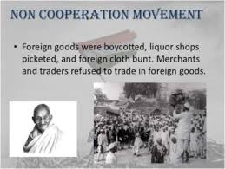
The Happenings of 1922-29
In February 1922 a crowd of peasants set fire to a police station in Chauri Chaura, Gandhiji called off the Non-Cooperation Movement.
Chittranjan Dass and Motilal Nehru argued that the party should fight elections to the councils and enter them in order to influence government policies.
Civil disobedience Movement was launched in 1930 under the leadership of Gandhiji.
The formation of the Rashtriya Swayamsevak Sangh (RSS) and the Communist Party of India were the two important development of the mid-1920s.
The Congress resolved to fight for ‘Purna Swaraj’ in 1929 under the presidentship of Jawaharlal Nehru and 26 January 1930 was observed as ‘Independence Day’ all over the country.

Slide 10
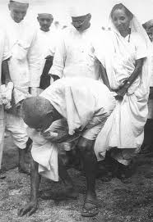
Dandi March
In 1930, Gandhiji started the march to break the Salt Law. According to this law the state had a monopoly on the manufacture and sale of salt.
Gandhiji and his followers marched from Sabarmati Ashram to the coastal town of Dandi where they broke the Salt law by gathering natural salt found on the sea-shore are boiling sea water to produce salt.
The combined struggles of the Indian people bore fruit when the Government of India Act of 1935 prescribed provincial autonomy and the government announced election to the provincial legislature in 1937.
The Second World War broke out in September 1939. The Congress leaders were ready to support the British war effort. But in return they wanted that India be granted Independence after the war. The British refused to concede the demand andthe Congress ministers resigned in protest.

Slide 11
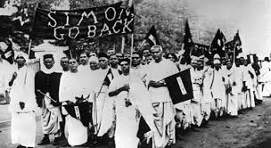
Quit India Movement
Mahatma Gandhi decided to initiate a new phase of movement against the British in the middle of the Second World War which was Quit India Movement.
Quit India Movement demanded end to British rule.
Gandhi made a call to Do or Die in his Quit India speech delivered in Bombay at the Gowalia Tank Maidan.
The first response of the British was severe repression and the end of 1943 over 90,000 people were arrested, and around 1,000 killed in police firing.

Slide 12
Towards Independence and Partition
In 1940, the Muslim League had moved a resolution demanding ‘Independent States’ for Muslims in the north-western and eastern areas of the country.
The provincial elections of 1937 seemed to have convinced the League that Muslims were a minority, and they would always have to play second fiddle in any democratic structure.
The Congress’s rejection of the League’s desire to form a joint Congress-League government in the United Provinces in 1937 also annoyed the League.
In 1945, after the end of the war, the British opened negotiations between the Congress, the League and themselves for the Independence of India. The talks failed because the league accelerated the demand for Pakistan.
In March 1946 the British cabinet sent a three-member mission to Delhi to examine this demand. 16 August 1946 was declared as the ‘Direct Action Day’ by the league.
On 3 June 1947, the Partition Plan was announced and Pakistan came into existence. The joy of our country’s Independence from British rule came mixed with the pain and violence of Partition.

Slide 13
Credits
Created by:
SOHAM JOSHI
NAMEER SHAIKH
ANKIT WANKHEDE

Slide 14
THANK YOU

